Slide 1

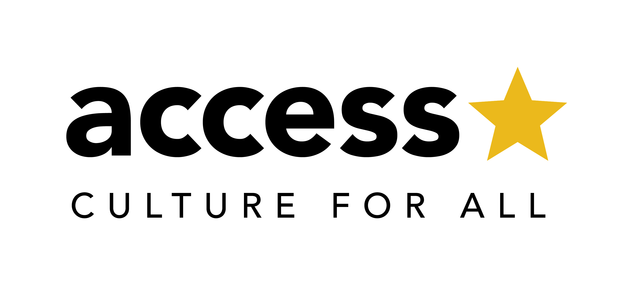
Lisbon Transnational Meeting
March 2021

Slide 2

The Lisbon TransNational Meeting
AIMS
To further the ACCESS partnership with networking, knowledge sharing and inspiration
To learn from and about Lisbon’s practice, reflecting on lessons in cultural inclusion
for ACCESS cities
To provide support and guidance for IAPs
INVITATION
This meeting is for all ACCESS partner cities, their core teams and their ULGs.
**There is no limit to the number of attendees per city – but we do ask that attendees EITHER commit to the full three mornings (participants), OR that they join solely for the presentation sessions (audience). This allows us to maintain the spirit of ACCESS, with both engaged conversation and the widest possible sharing. We ask that all attendees are booked in in advance and this agenda is shared with everyone joining us.**
We look forward to seeing you in “Lisbon” 17 – 19 March!
Bem-vindo a Lisboa

Slide 3
Three Things To Do Right Now!
Who’s coming? Send list of attendees (names, roles and emails) from your city. Please state whether participants are participants (coming to all sessions) or audience (joining for presentations only). Deadline 5th March.
Share this agenda pack with your participants.
Seen some great practice? Please share examples (brief paragraph and web link) of creative ways of including and connecting through culture during the pandemic. We will gather and circulate these as our next ACCESS guidebook for pre-reading before the meeting. Deadline 10th March.
    Replies to c.ozcelik@Amsterdam.nl and rebekah.polding@gmail.com

Slide 4
Three Things To Do In Preparation
Read the agenda and meeting guidelines; read the latest ACCESS guidebook to get you in the mood for international inspiration. Make sure you have a comfortable set up, pens and paper.
Find a picture of your city with meaning for you right now and install it as your ‘virtual backdrop’ on Zoom.
Questions? Concerns? Think through the ACCESS project from your perspective and note down anything you wish to have covered. We’ll ask you to contribute these thoughts during the meeting and will hope to address all issues either during our three days activation or in follow up sessions.

Slide 5
TransNational Meeting Guide
Please rename yourself “CITY_Name”. This will make it easier for new colleagues to learn where you are from.
Video should be ON unless you are told otherwise; be present in the meeting.
Please stay on MUTE unless requested otherwise. Use CHAT, WAVE or the RAISED HAND if you’d like to speak.
Please use the CHAT throughout! This is a good way to maintain conversation and contribute thoughts and questions. We’ll have someone monitoring this to pick up what is being said and feed this in to the meeting.
SHOUT, WAVE, CHAT, RAISE HAND if there is a technical problem; we’ll try and fix this straight away. Though we all know this may not be easy!
Please have PAPER AND PENS at the ready; you will need these for some of the workshop sessions.
Cats, dogs and children are all fine: don’t worry if there is an unexpected meeting guest. But please don’t take work calls or check emails.
Pro-tip I: Zoom has a ‘touch up my appearance’ feature! (Settings > Meetings > Touch up my appearance)
Pro-tip II: Virtual Backgrounds are in Profile Picture > Settings > Virtual Background.
The meetings will open for participants 15 minutes before formal business begins on each day for music and informal chat. Please make sure you join no later than 5 minutes before time to ensure a prompt start.
For audience sessions please sign in 5 minutes in advance of session start time. Another session may still be running; please wait and we will welcome you when the audience session begins.
Be Kind! The Virtual Meeting World isn’t always easy but we are here to support one another..

Slide 6
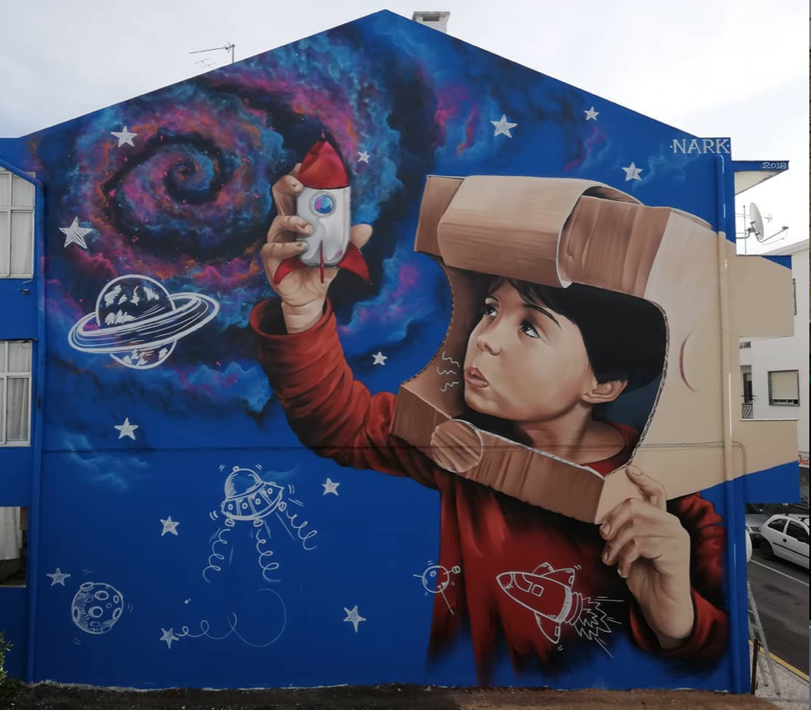
Day I Arrival in Lisbon
Weds 17 March,
10:00 – 13:00 (CET)
9.45 Meeting room opens
10.00 Welcome to Lisbon!
10.30 Culture in Lisbon
10.55 BREAK
11.10 Workshop: Shared Challenges, Different Structures
12.00 Case Study: Muro Urban Art Festival
13.00 CLOSE
Sessions for participants
Presentation sessions for audience also

Slide 7

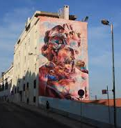
Case study: Muro Urban Art Festival
Muro Festival
The MURO Festival (Lisbon) advocates the use of urban art as a tool for the creation of new urban centralities and the consequent preference for peripheral areas of the municipal territory - geographically and socially speaking - as a destination and useful use to give to GAU (Urban Art Gallery) projects, as a motor for valorization of municipal housing, of public space, creating a social and community appropriation of the works, thus creating decentralized routes and public art galleries in the city that promote these territories.
Speaker: Hugo da Nóbrega Cardoso
Hugo Cardoso studied theatre and cinema (New York Film Academy, Restart and Fine Arts School), where he began to develop social and community intervention programs in degraded neighborhoods on the outskirts of Lisbon, where he created projects such as the Festival O Bairro I O Mundo (The Neighborhood And The World), cinema and theater formations, and created the Public Art Gallery of Loures, did artistic direction at Teatro Ibisco (Opressed and Forum Theater – Augusto Boal), and made 3 documentaries on art and socio-community intervention. Today at the Lisbon City Council he is the coordinator of the Urban Art Gallery.

Slide 8
Day II Strolling along the Rua Cor de Rosa
Thurs 18 March,
10:00 – 13:00 (CET)
9.45 Meeting room opens
10.00 The IAP
10.30 Speaker presentation: Bill Thompson, Digital Inclusion
11.30 BREAK
11.40 Workshop: Reflecting Digital Inclusion in our IAPs
12.15 Case Study: Rossio de Palma Square
13.00 CLOSE
Sessions for participants
Presentation sessions for audience also

Slide 9
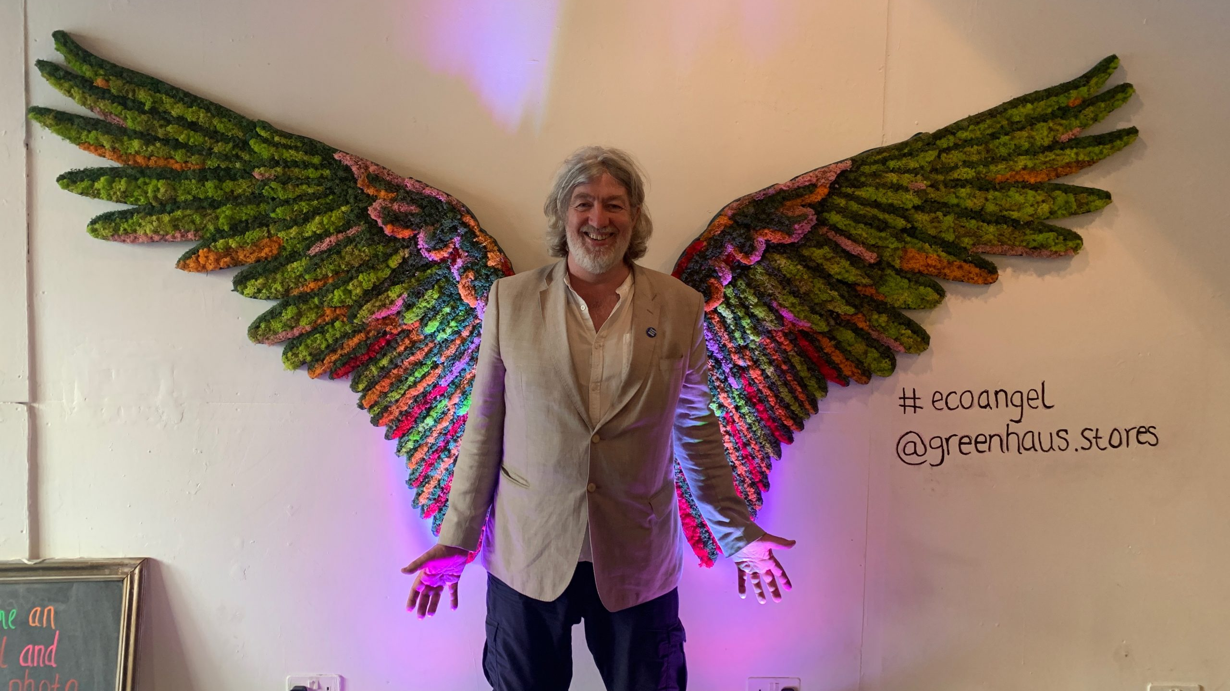
Speaker Presentation: Digital Inclusion
Since the pandemic began, culture has been forced to deliver in the digital realm. And for the ACCESS project, focused on cultural inclusion, this raises a key question around inclusion – who is and isn’t included in the digital world, and how do we make digital culture inclusive?
Journalist and technologist Bill Thompson (@billt) will discuss what digital inclusion means, how to achieve it – and how things can go badly wrong.
Bill Thompson is a Principal Engineer in BBC Research & Development working on ways the BBC can deliver its public service mission online as joint lead for the New Forms of Value research programme. A well-known technology journalist, Bill appears regularly on Digital Planet on BBC World Service radio and writes for a range of publications. He is an Adjunct Professor at Southampton University and member of the Web Science Institute advisory board.
Bill has been working in, on and around the Internet since 1984, and was Internet Ambassador for PIPEX, the UK’s first commercial ISP, and Head of New Media at Guardian Newspapers where he built the paper’s first website.
He is a former member of the boards of Writers’ Centre Norwich, Britten Sinfonia, and the Cambridge Film Trust. In 2016 he was awarded an Honorary Doctorate of Arts by Anglia Ruskin University and from 2013-1206 he was a Visiting Professor at the Royal College of Arts.

Slide 10
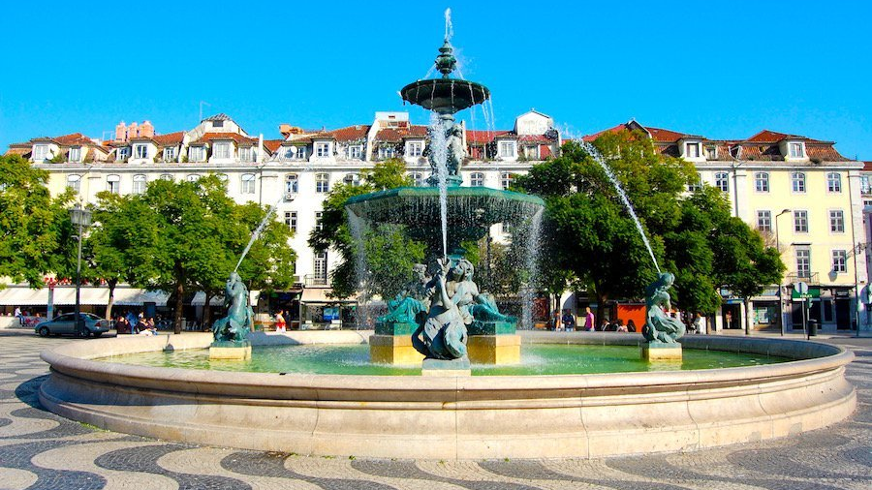
Case study: Rossio de Palma Square
Rossio de Palma Square
Set in a popular neighbourhood where a village-style square and its surrounding houses are framed by high, modern buildings, the urban renewal plan - “A square in each neighbourhood” – drew away the local inhabitants.
Framed as a pilot measure of Agenda 21 for Culture, our idea was to add a cultural dimension to the original rehabilitation plan of the square provoking the reappropriation of this public space, through artistic interventions, participatory projects and events focused on the shared memories and living experiences of its inhabitants.
For a one year, a series of meetings with the inhabitants revolved around the question: ‘What do we want to do with our square?’. A member of our team would stand in the Square every Friday morning for several months and wait for the inhabitants to bring her their souvenirs - stories, photos, objects and other memories of the neighbourhood.
Speakers: Alexandra Sabino and Collective Warehouse
Alexandra Sabino studied international relations and began her activity in cultural production in the University Theatre of Minho in 1998. She worked in Porto 2001 - European Capital of Culture for the Community involvement area. In 2002, worked in the contemporary dance platform “Mudanças” and in the same year starts working with Teatro Bruto, a theater company from Porto. In 2006, she begins her duties at the Madeira Classical Orchestra as assistant to the Artistic Director. She was production director at the contemporary dance Company Clara Andermatt (2007-2015). Currently she is advisor to the Deputy Mayor for Culture of Lisbon's City Council.
Colectivo Warehouse is a Lisbon based collective working across architecture, product design and art. Since 2013, Warehouse has been working on different scales around Europe, deeply involved on cultural and social projects. Combining multi-disciplinary tools from architecture, urbanism, sociology, carpentry and design, it has been developing its own methodologies based on participation, engagement and co-creation, that have been producing successful projects in Portugal and abroad. Ruben Teodoro, co-founder of the collective, will be sharing the process, methodologies and outcomes behind “Portal de Palma” participative artistic intervention, held in 2019 in Palma neighborhood, Lisbon.

Slide 11
Day III At the Castelo de Sao Jorge
Friday 19 March,
10:00 – 12:30 (CET)
9.45 Meeting room opens
10.00 Case study: Data – Generator Barometer
11.00 BREAK
11.15 Workshop: What will success look like?
12.00 Plenary
12.30 CLOSE
Sessions for participants
Presentation sessions for audience also

Slide 12
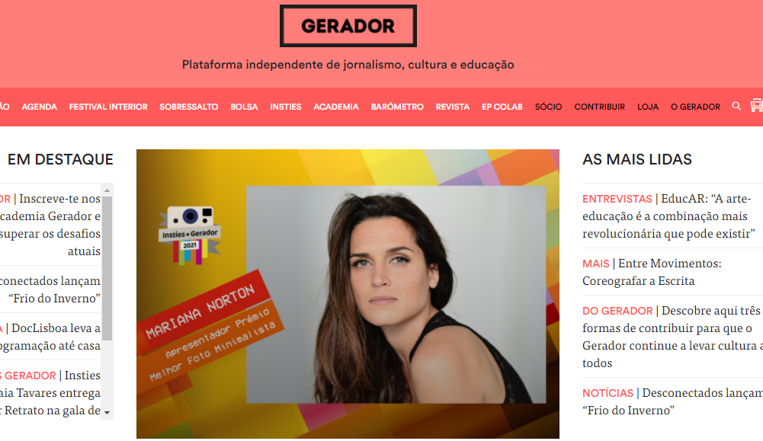
Case study: Data – Generator Barometer
Barómetro Gerador Qmetrics
Gerador is an independent Portuguese platform for journalism, culture and education. Besides giving an overview of their experience as a cultural agent based in Lisbon, they will present the Barómetro Gerador Qmetrics, the only existing opinion study that researches the relevance and consumption of culture as it is perceived by the Portuguese population, carried out in partnership with an experienced consultancy company, Qmetrics. Through sharing the data they have collected and analyzed, Gerador aims to open a discussion on the importance of opinion studies within the cultural field.
Speakers: Clara Amante and Tiago Sigorelho
Clara Amante (1995) has an MA in Arts and Society from the Utrecht University (NL) and a bachelor’s in Communication Sciences from the NOVA University of Lisbon (PT). She has worked in event production, communication, research and project management both at Gerador and at Stichting art.1, a Dutch NGO that works mostly with trans-European projects. Clara is currently back at Gerador, where she is head of the Academia, a project which encompasses cultural research, data analysis and education. She takes part in the conception and analysis of the Barómetro Gerador Qmetrics.
Tiago Sigorelho, born in 1975, has a degree in corporate communication. His first 15 years of experience were connected to the telecommunications sector. In 1998 he started to work in Telecel and was the key manager of the Vodafone rebranding three years after. Later on, went to Portugal Telecom, the largest telecommunications company at the time, where he became Strategic Branding Director for all the operations in the group, national and internationally. In 2014 he was the founder of Gerador, a non-profit organization dedicated to fostering Portuguese culture. He is, since then, the president of Gerador. Lately, is main focus has been the relationship between culture and education, as well as the development of information tools and data analysis systems that enable the cultural communities to thrive.

